Slide 1
Created By : BYTE BUSTERS
HEALTH HAVEN

Slide 2

Problem Statement
Access Gap
India's doctor-population ratio of 1:834 highlights a significant healthcare access challenge. This imbalance necessitates strategies to increase the availability of medical professionals, especially in underserved areas.
Information Overload
The internet offers a vast sea of medical information, but navigating this information can be overwhelming and confusing for individuals seeking reliable medical
guidance.

Slide 3








Integrating Diverse Medical Perspectiv es
Ayurveda
Ayurveda, a traditional Indian system of medicine, focuses on holistic wellness and emphasizes the connection between mind, body, and spirit.
Western Medicine
Western medicine, based on scientific evidence, employs a variety of treatments to diagnose and treat diseases.
Alternative Therapies
Alternative therapies, such as acupuncture, yoga, and aromatherapy, offer a complementary approach to healthcare.

Slide 4




Personalized Health Recommendations
User Profile Symptom Analysis
The AI-powered health advisor gathers information about a user's health history, lifestyle, and preferences to create a personalized profile.
The system analyzes user input, such as symptoms, medical history, and lifestyle choices, to generate a list of potential diagnoses.
Tailored Recommendations
Based on the user's profile and symptom analysis, the advisor provides tailored recommendations, including medical advice, lifestyle suggestions, and alternative therapies.

Slide 5





Feasibility and Viability
Availability of Data
Vast amounts of medical data are available through electronic health records, research publications, and online resources.
Available User Trust and Adoptionility of Data
Scalibility
The AI system must handle a large number of users simultaneously while maintaining accuracy and speed. Scalability is a technical challenge that involves robust infrastructure and optimization
For a health advisor AI to be viable, users need to trust the system. This involves not only the accuracy of advice but also transparency in how decisions are made and data is handled

Slide 6




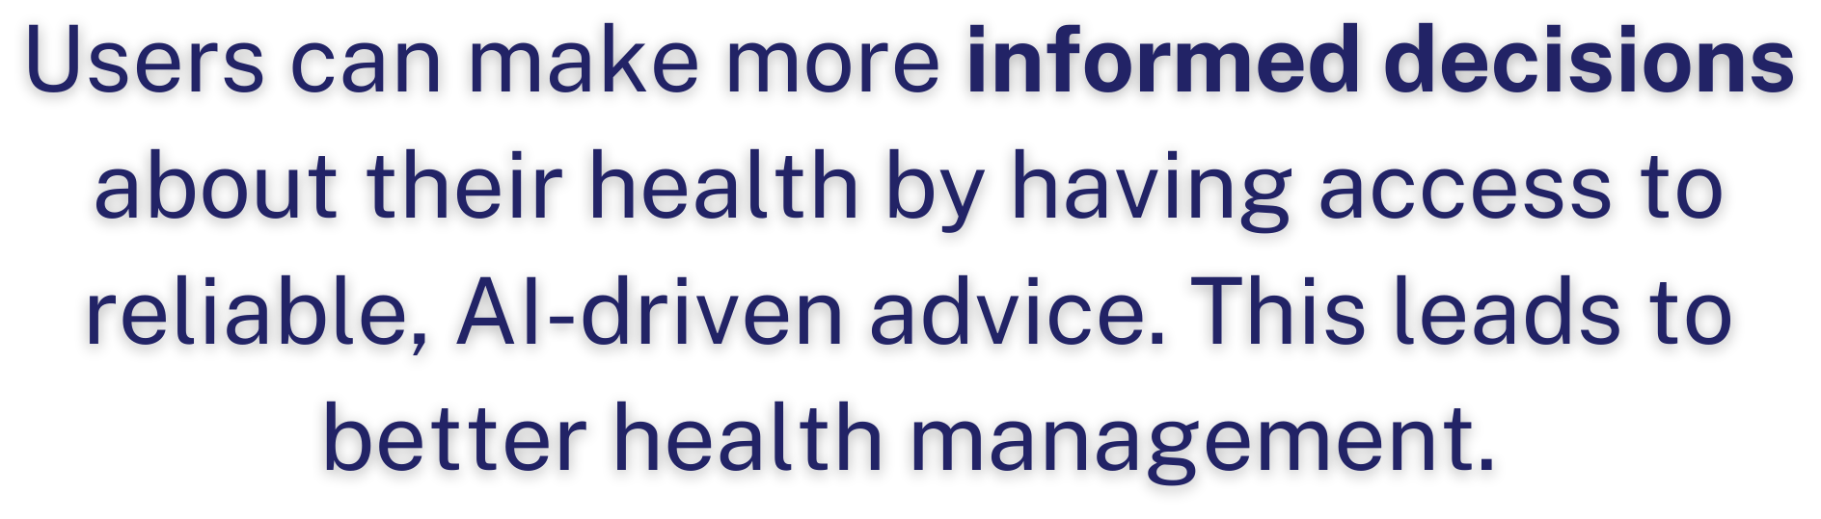






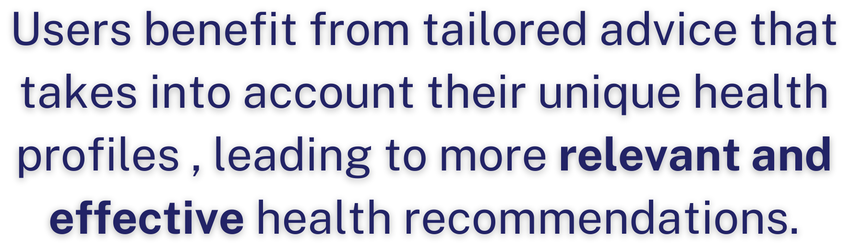





Impact and Benefits
Improved Access to Healthcare: The platform can provide immediate health advice and information, especially in areas with limited access to healthcare professionals.

Slide 7


Slide 8
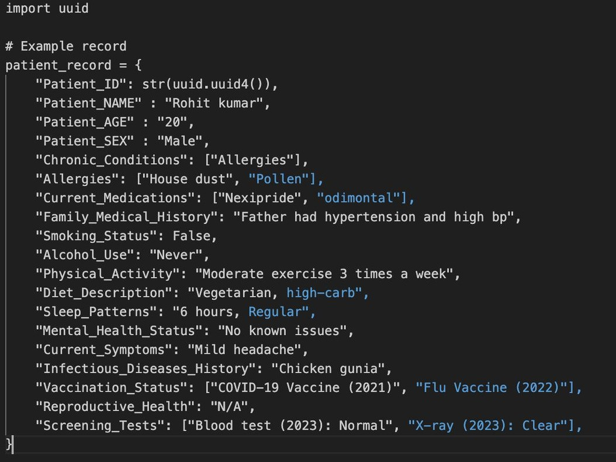

Slide 9
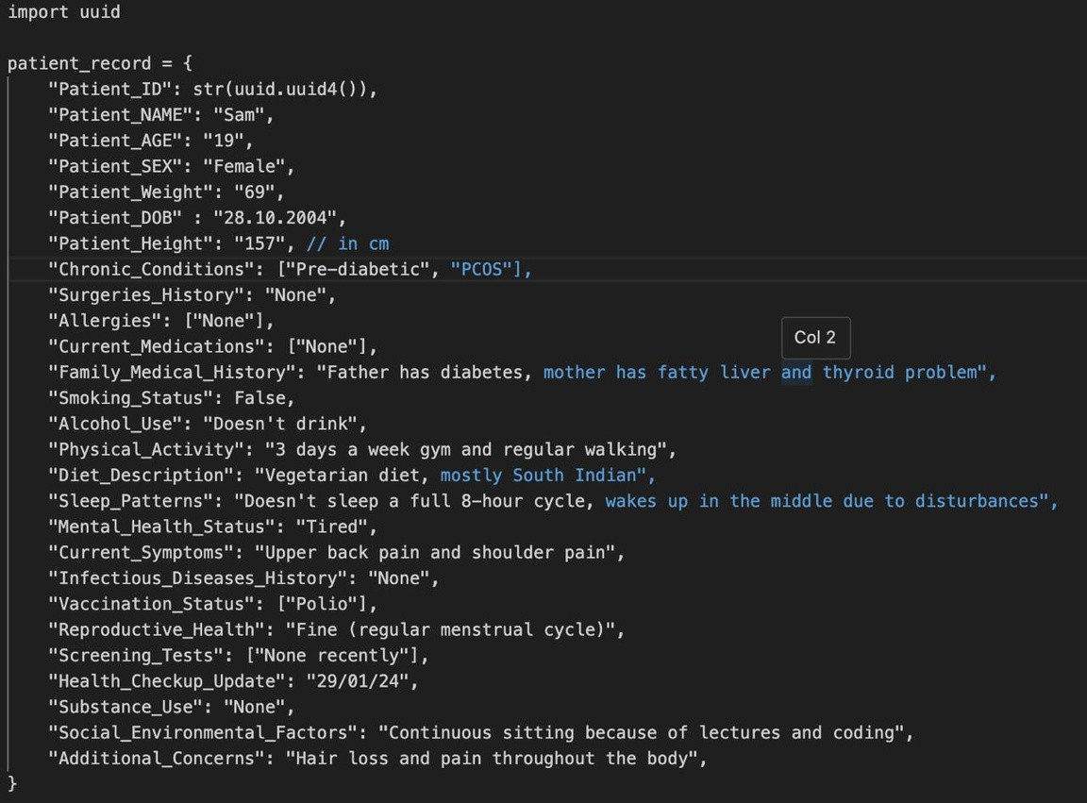

Slide 10
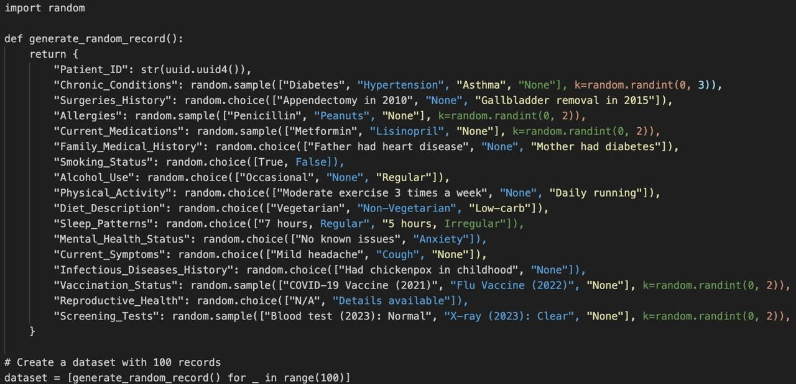

Slide 11
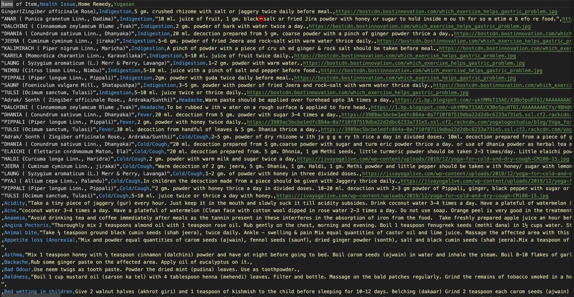

Slide 12








Thank you !

